Slide 1
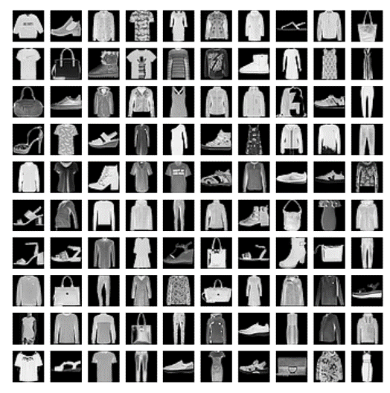
How do you know it‘s a Shirt?
Implementation and comparison of K-nearest neighbors (KNN) and convolutional neural network (CNN) for clothes recognition
Topic 01
Group 04
Anastasia Warken, Bastian Mucha, Heinrike Gilles, Ole Decker

Slide 2
1. Material
Dataset
Overview
2. Methods
Data preparation
KNN
CNN
Evaluation
3. Results
4. TEIL:
Zusammenfassung

Slide 3
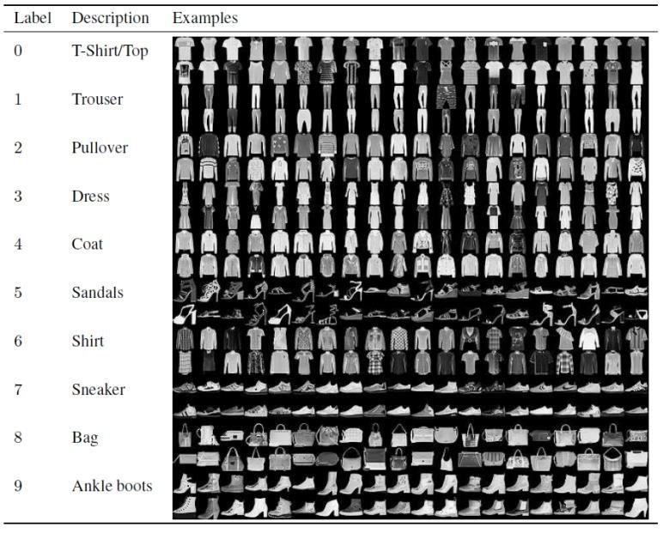
MATERIAL
Fashion-MNIST Dataset
Training set 60.000 images
Test set 10.000 images
28 x 28 pixels grayscale
CSV files (Comma-separated values)
One Row = one image
Intensity values: 0 - 255
Fashion-MNIST Dataset Images with Labels and Description II. LITERATURE... | Download Scientific Diagram (researchgate.net)
Notes:
MNIST: Modified National Institute of Standards and Technology database
Training set 60.000 images
Test set 10.000 images
28 x 28 pixels grayscale
10 different classes (noted in first column)
CSV files (Comma-separated values)
Size-normalized & centered (visually)
each row is one image with values from 0 to 255

Slide 4
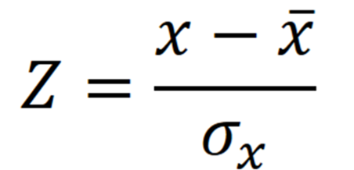
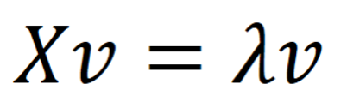
METHODS
Data preparation
Z-transformation
Principal Component Analysis (PCA)

Slide 5
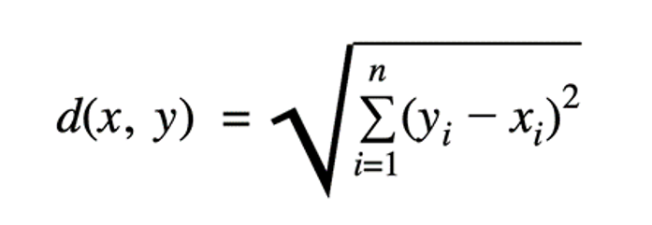
METHODS
K-nearest neighbors (KNN)
nonparametric, supervised learning algorithm
For classification problems
Predictions based on similarity to training data points
Majority vote

Slide 6

METHODS
Convolutional Neural Network (CNN)
deep learning model
for analysis of visual data
detects patterns in a hierarchical structure
different types of layers
Basic CNN Architecture: Explaining 5 Layers of Convolutional Neural Network | upGrad blog

Slide 7
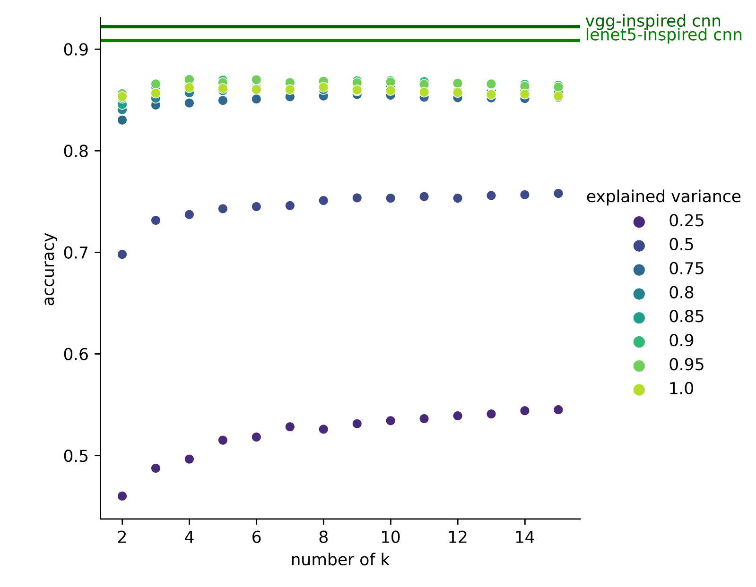
RESULTS
PCA
Optimal number of k and PCs
- 784 Eigenvectors
Optimal k = 4
Variance 95%
256 Eigenvectors

Slide 8
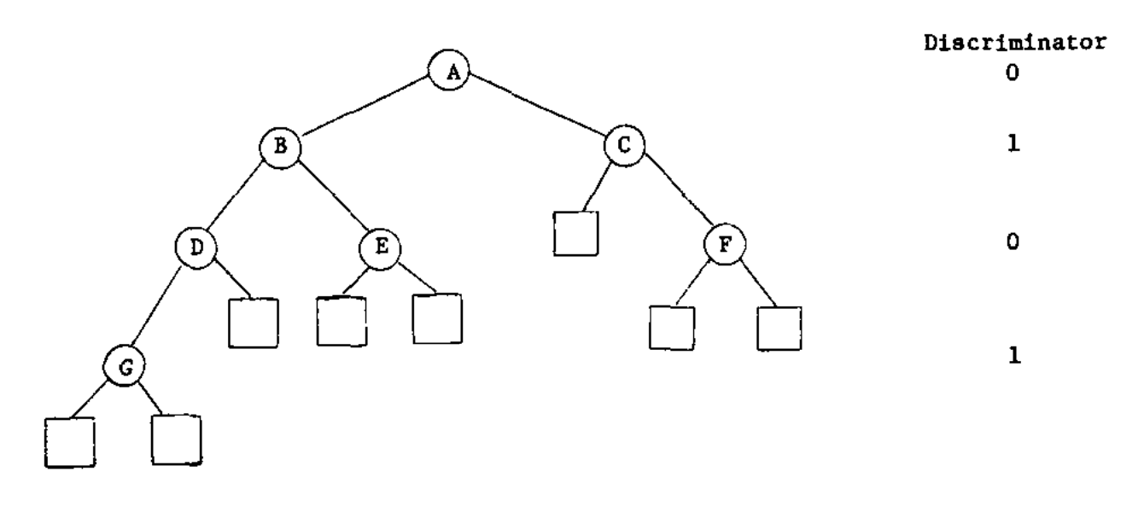
RESULTS
KNN
What‘s a KD-Tree?
- Run time 40 images: 26.4 seconds
- Bla bli blub
KNN with KD-Tree
Run time 10,000 images: 26.9
Leaf size 10
Accuracy: 86.3%

Slide 9
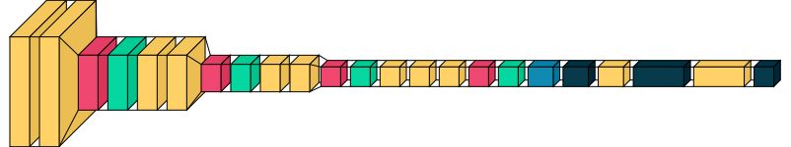
RESULTS
CNN
KNN
Training & run time
Accuracy: 92.9%
Accuracy: 86.3%

Slide 10
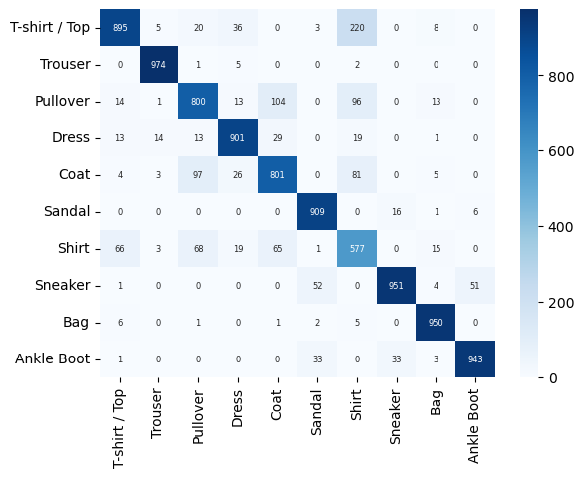
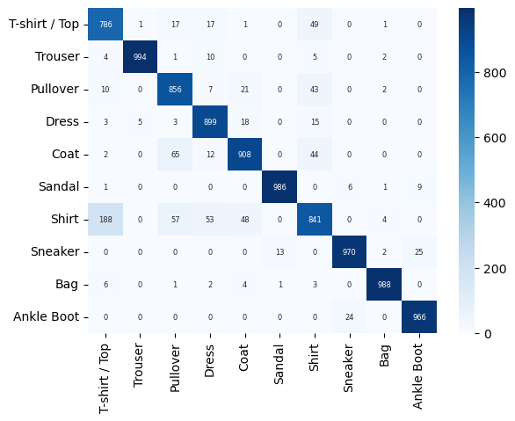
RESULTS
Confusion matrices
KNN
CNN
Where Highest confusion?
Klassifizierungsentscheidung bei tie
Was war hier besser?

Slide 11
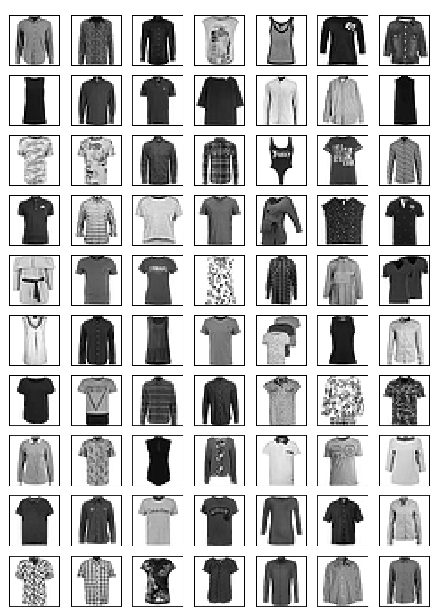
RESULTS
T-Shirt/Top vs. Shirt problem
?

Slide 12
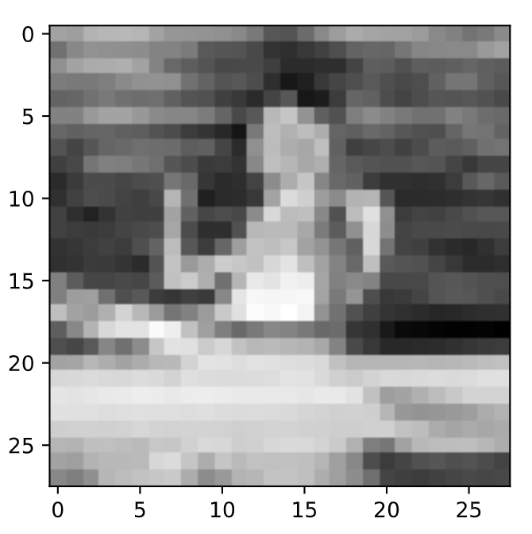
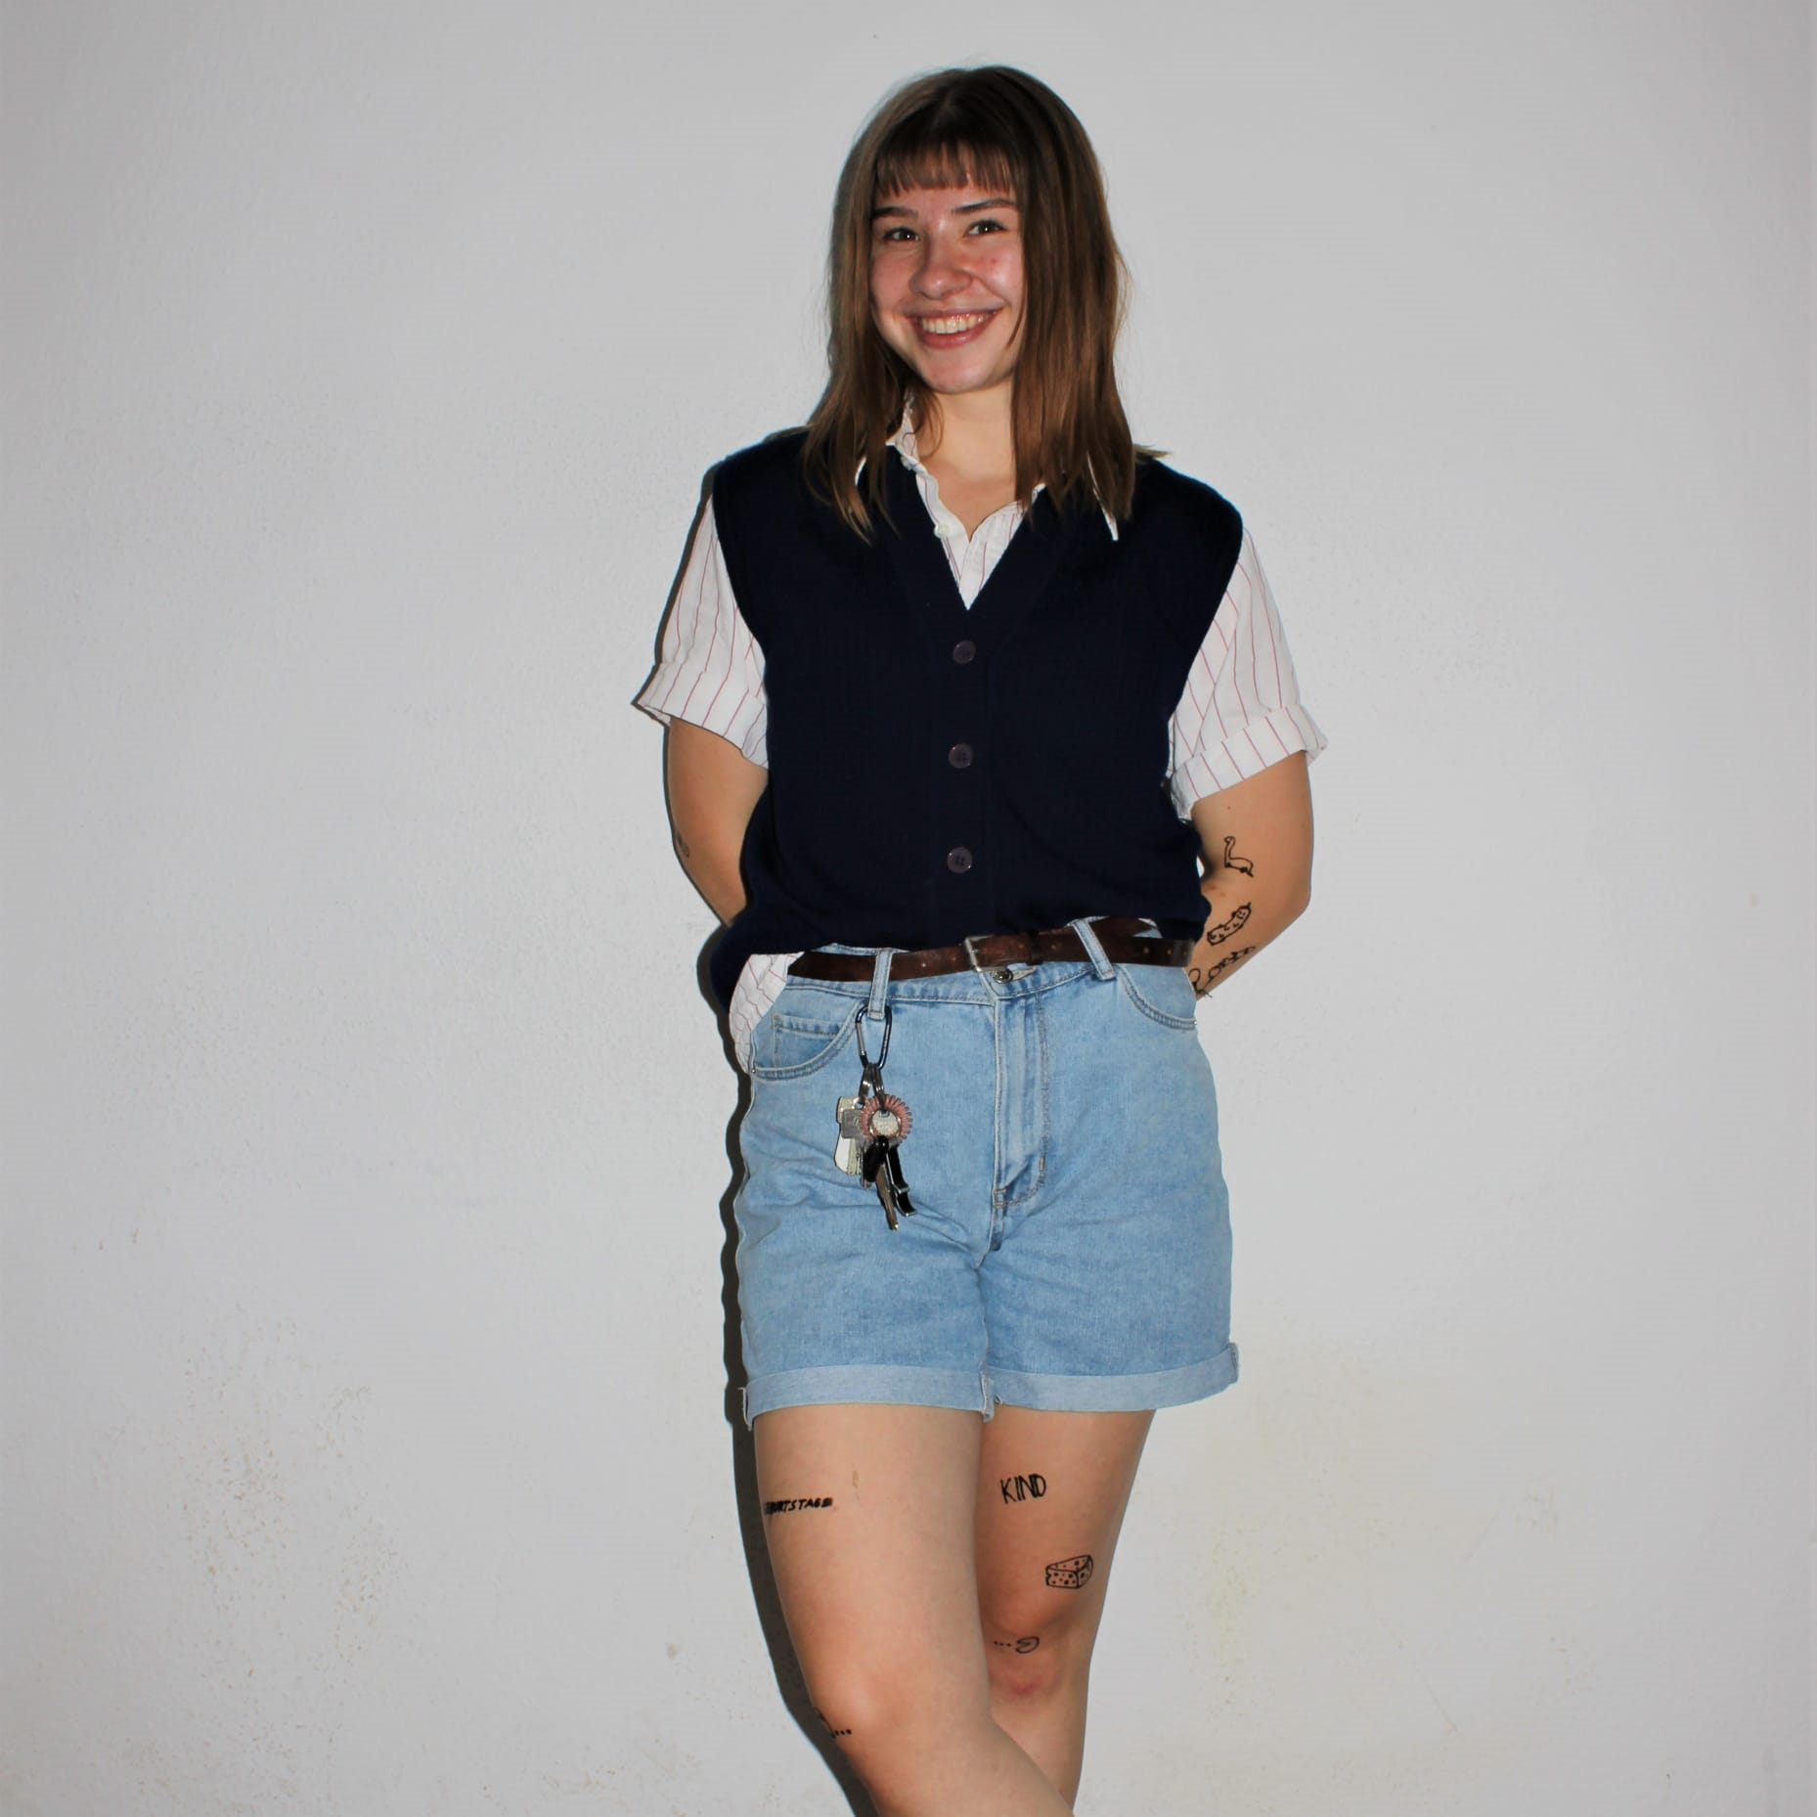
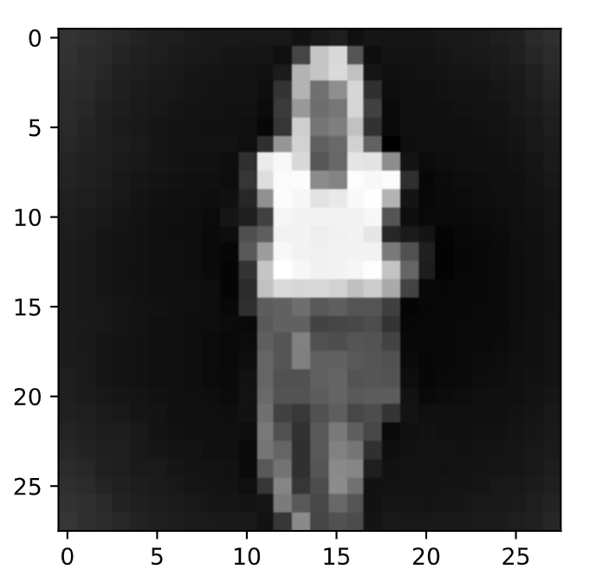

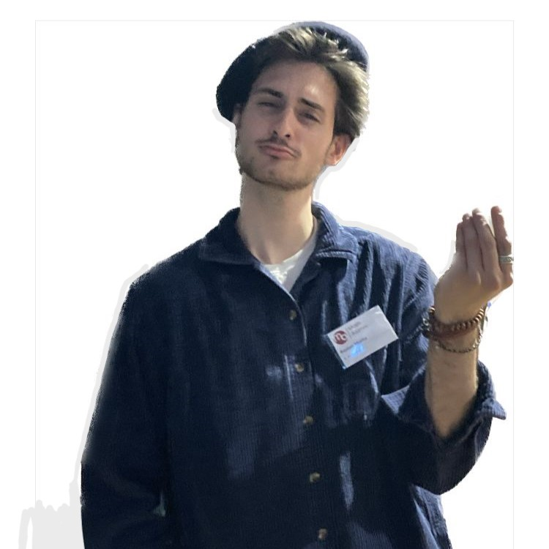
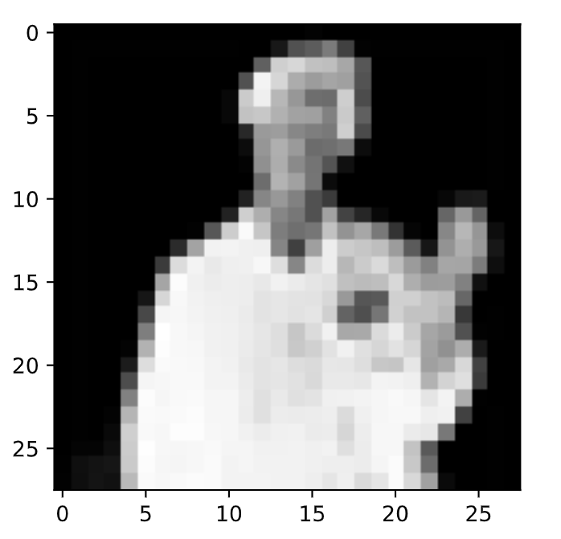
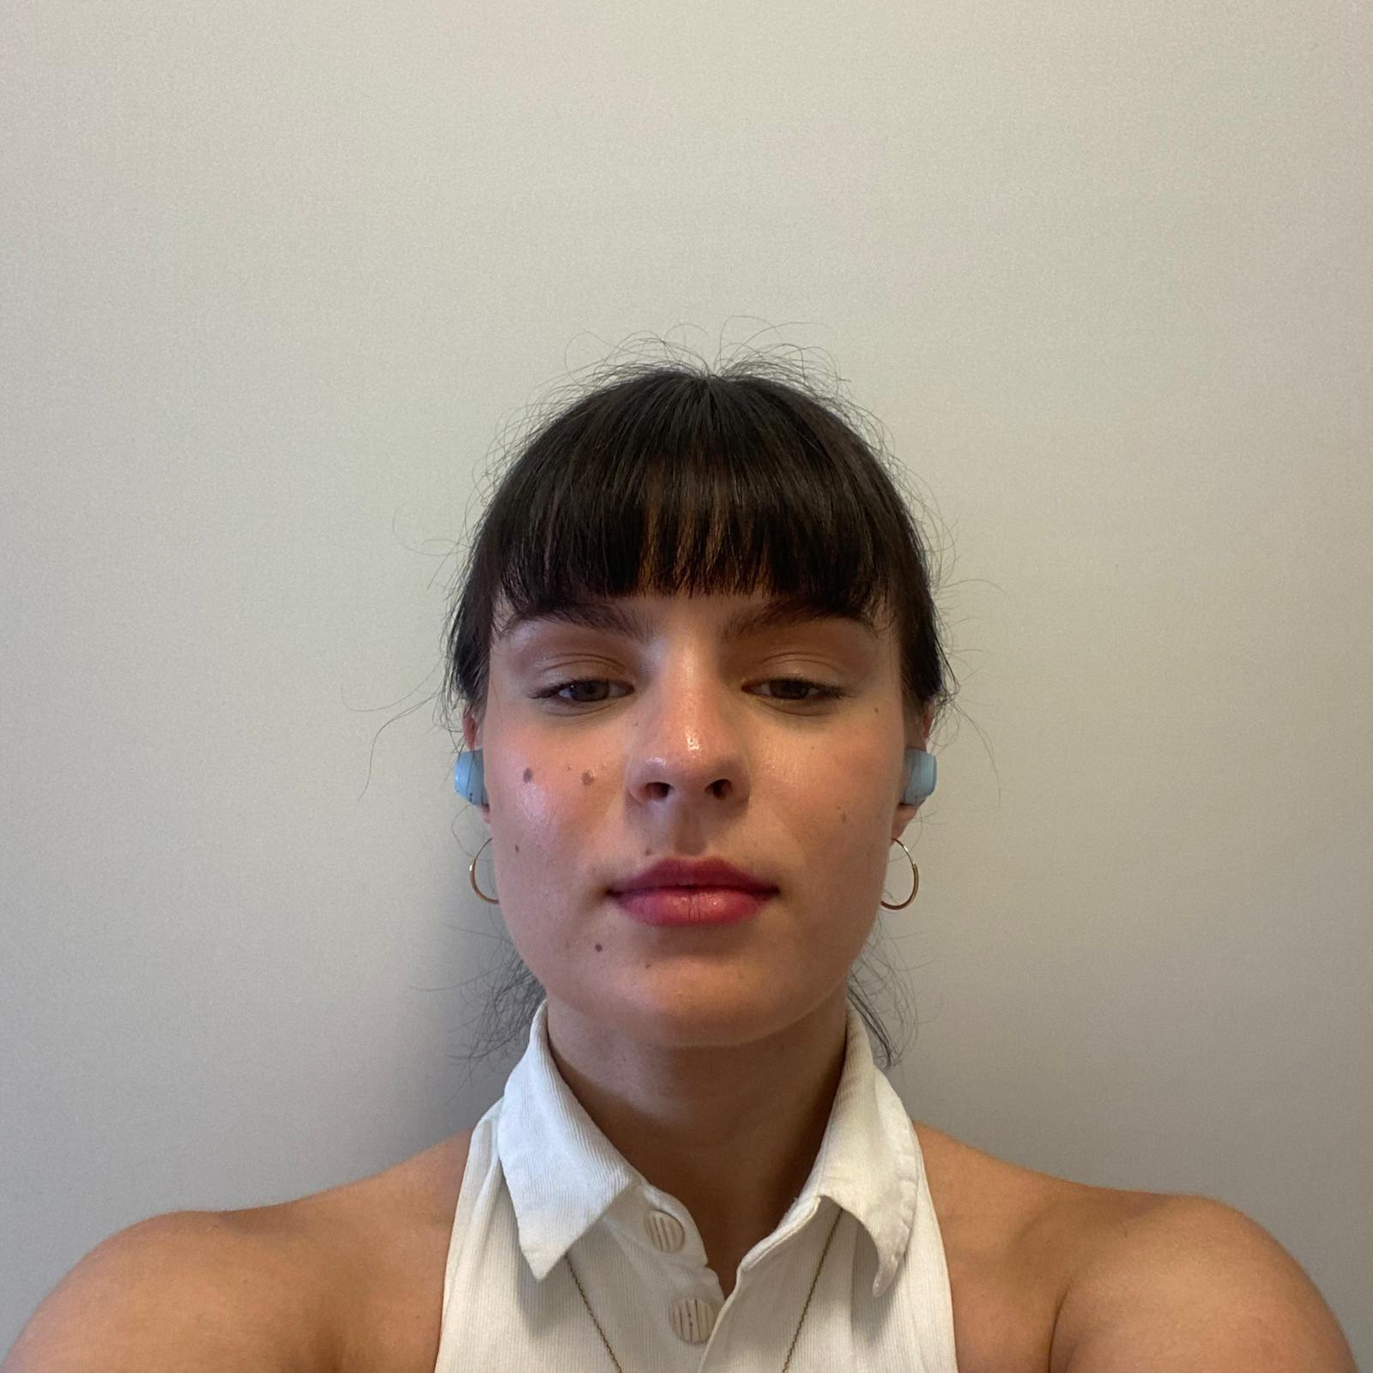
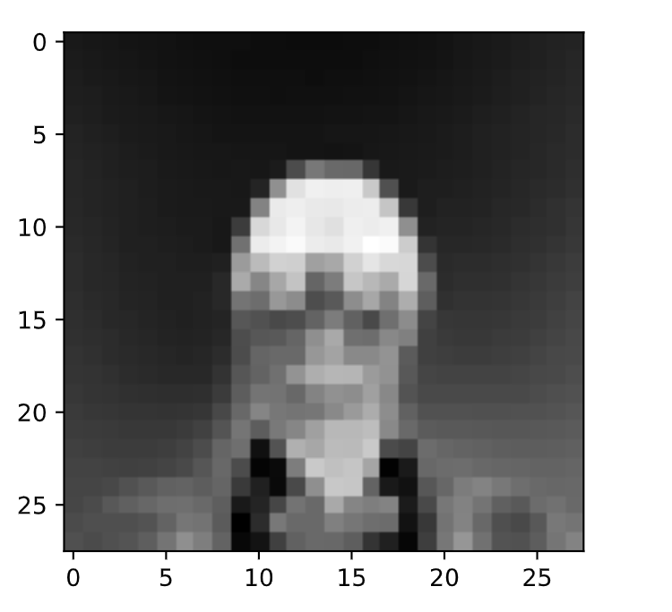
Our Team
Ole Decker
Shirt
Heinrike Gilles
Trouser
CNN quickly reaches its limit when dealing with pictures of people wearing clothes
Bastian Mucha
Sandal
Anastasia Warken
Ankle Boot

